Slide 1


Green Pace
Security Policy Presentation
Developer: Abby Ramatowski
Notes:
The following presentation outlines the security policy presentation for Green Pace. My name is Abby Ramatowski and I have developed and will be presenting this security policy.

Slide 2

OVERVIEW: DEFENSE IN DEPTH
Green Pace Secure Development Policy
Policy needed because:
Will help protect the organization’s assets from threats
Provides a concrete policy to be followed
Will be used to support defense in depth by enforcing multiple layers of security
Notes:
Green Pace’s secure development policy will be implementing defense in depth with multiple layers of security. This policy is needed because it will help protect the organization’s assets from threats, and it provides a concrete policy to be followed. This policy will enforce multiple layers of security.

Slide 3
THREATS MATRIX
Likely Data Value: Use valid references, pointers, and iterators to reference elements of a basic string String Correctness: Do not attempt to create a std::string from a null pointer Memory Protection: Properly deallocate dynamically allocated resources SQL Injection: Sanitize data passed to complex subsystems Exceptions: Handle all exceptions thrown before main() begins executing Iterators: Use valid iterator ranges Object Oriented Programming: Copy operations must not mutate the source code | Priority Data Value: Use valid references, pointers, and iterators to reference elements of a basic string String Correctness: Do not attempt to create a std::string from a null pointer Memory Protection: Properly deallocate dynamically allocated resources SQL Injection: Sanitize data passed to complex subsystems Iterators: Use valid iterator ranges
Low priority Data Type: Understand the data model used by your implementations Assertions: Use a static assertion to test the value of a constant expression Exceptions: Handle all exceptions thrown before main() begins executing Object Oriented Programming: Copy operations must not mutate the source code Concurrency: Wrap functions that can spuriously wake up in a loop | Unlikely Data Type: Understand the data model used by your implementations Assertions: Use a static assertion to test the value of a constant expression Concurrency: Wrap functions that can spuriously wake up in a loop
Notes:
This table outlines the potential threats. The more likely and costly threats will be higher priority than the unlikely and less costly threats.

Slide 4
10 PRINCIPLES
Validate Input Data – Data type: understanding the data model used should be followed when validating input data to avoid making errors about the sizes of integer types and the range of values they can represent.
Heed Compiler Warnings – String correctness: Dereferencing a null pointer is undefined behavior and can lead to execution of arbitrary code.
Architect and Design for Security Policies – Iterators: using an invalid iterator range can lead to an attacker running arbitrary code.
Keep It Simple – Memory Protection: deallocate dynamically allocated resources.
Default Deny - Exceptions: throwing an exception that cannot be caught can lead to denial-of-service attacks
Adhere to the Principle of Least Privilege – Object Oriented Programming: copy operations that mutate the source operand can lead to unexpected program behavior.
Sanitize Data Sent to Other Systems – SQL injection: failure to sanitize data sent to a complex subsystem can lead to an injection attack.
Practice Defense in Depth – Concurrency: failure to wrap functions inside a loop can lead to indefinite blocking and denial of service.
Use Effective Quality Assurance Techniques – Assertions: Static assertions can be used to find and eliminate software defects at compile time.
Adopt a Secure Coding Standard – Data value: adopting a secure coding standard that requires that valid references, pointers, and iterators to reference elements of a basic string can prevent an attacker from being able to rub arbitrary code.
Notes:
In order to follow the 10 coding principles, each will adhere to the following standards:
Validate input data by understanding the data model used. This should be followed when validating input data to avoid making errors about the sizes of integer types and the range of values they can represent.
Heed compiler warnings by dereferencing a null pointer; this is undefined behavior and can lead to execution of arbitrary code.
Architect and design for security policies by using valid iterator ranges; using an invalid iterator range can lead to an attacker running arbitrary code. Keep it simple by deallocating dynamically allocated resources.
Default deny by handling all exceptions thrown before main() begins executing; throwing an exception that cannot be caught can lead to denial-of-service attacks.
Adhere to the principle of least privilege by ensuring that copy operations not mutate the source object; copy operations that mutate the source operand can lead to unexpected program behavior.
Sanitize data sent to other systems by sanitizing data sent to a complex subsystem; failure to do this can lead to an injection attack.
Practice defense in depth by wrapping functions that can spuriously wake up in a loop; failure to wrap these functions can lead to indefinite blocking and denial of service.
Use effective quality assurance techniques by using a static assertion to test the value of a constant expression; static assertions can be used to find and eliminate software defects at compile time.
Adopt a secure coding standard by using valid references, pointers, and iterators to reference elements of a basic string; adopting a coding standard that requires this can prevent an attacker from being able to run arbitrary code.

Slide 5
CODING STANDARDS
Data Type – Understand the data model used by your implementation(s).
Level 3 priority due to high severity and remediation cost but unlikely to occur (Seacord & Razmyslov, 2021).
Data Value – Use valid references, pointers, and iterators to reference elements of a basic string
Level 5 priority due to high severity, remediation cost, and likely to occur (Long & O’Donnell, 2021).
String Correctness – Do not attempt to create a std::string from a null pointer.
Level 5 priority due to high severity, medium remediation cost, and likely to occur (Ballman & Britton, 2021).
SQL Injection – Sanitize data passed to complex subsystems.
Level 5 priority due to high severity, medium remediation cost, and likely to occur (Seacord & Herter, 2020).
Memory Protection – Properly deallocate dynamically allocated resources
Level 5 priority due to high severity, medium remediation cost, and likely to occur (Ballman, & Britton , 2021).
Notes:
The following coding standards will be implemented:
Regarding data type, understand the data model used by your implementations. This standards is a level 3 priority due to high severity and remediation cost but unlikely to occur.
Regarding data value, use valid references, pointers, and iterators to reference elements of a basic string. This is a level 5 priority due to high severity, remediation cost, and likely to occur.
Regarding string correctness, do not attempt to create an standard string from a null pointer. This is a level 5 priority due to high severity, medium remediation cost, and likely to occur.
Regarding SQL injection, sanitize data passed to complex subsystems. This is level 5 priority due to high severity, medium remediation cost, and likely to occur.
Regarding memory protection, properly deallocate dynamically allocated resources. This is level 5 priority due to high severity, medium remediation cost, and likely to occur.

Slide 6
Coding Standards
Assertions – Use a static assertion to test the value of a constant expression
Level 1 priority due to low severity, high remediation cost, and unlikely to occur (Seacord & Britton, 2018).
Exceptions – Handle all exceptions thrown before main() begins executing.
Level 2 priority due to low severity, low remediation cost, and likely to occur (Seacord & Gangopadhyay, 2021).
Iterators – Use valid iterator ranges
Level 5 priority due to high severity, remediation cost, and likely to occur (Long & O’Donnell, 2021).
Object Oriented Programming – Copy operations must not mutate the source object.
Level 2 priority due to low severity, remediation cost, and likely to occur (Ballman & Britton, 2021).
Concurrency – Wrap functions that can spuriously wake up in a loop
Level 1 priority due to low severity, remediation cost, and unlikely to occur (Seacord & Britton, 2021).
Notes:
Regarding assertions, use a static assertion to test the value of a constant expression. This is level priority due to low severity, high remediation cost, and unlikely to occur.
Regarding exceptions, handle all exceptions thrown before main() begins executing. This is level 2 priority due to low severity, low remediation cost, and likely to occur.
Regarding iterators, use valid iterator ranges. This is level 5 priority due to high severity, remediation cost, and likely to occur.
Regarding object oriented programming, copy operations must not mutate the source object. This is level 2 priority due to low severity, remediation cost, and likely to occur.
Regarding concurrency, wrap functions that can spuriously wake up in a loop. This is level 1 priority due to low severity, remediation cost, and unlikely to occur.

Slide 7
ENCRYPTION POLICIES
Encryption in Rest
Encryption in rest is when data is encrypted on a hard drive. Applying the policy of encryption in rest prevents attackers from accessing data on a hard drive. They may obtain the hard drive with encrypted data but will not have access to the unencrypted data or the encryption keys and therefore cannot read the data.
Encryption at Flight
Encryption at flight is when data is encrypted when it is being transmitted within a network. Applying this policy ensures that all data is safe-guarded without using time-consuming solutions.
Encryption in Use
Encryption in use ensures that all sensitive or protected data is never left unencrypted at all stages of the lifecycle. Applying this policy ensures that there are not any stages where information is left unprotected.
Notes:
Encryption in rest, at flight, and in use will be followed.
Encryption in rest is when data is encrypted on a hard drive. Applying the policy of encryption in rest prevents attackers from accessing data on a hard drive. They may obtain the hard drive with encrypted data but will not have access to the unencrypted data or the encryption keys and therefore cannot read the data.
Encryption at flight is when data is encrypted when it is being transmitted within a network. Applying this policy ensures that all data is safe-guarded without using time-consuming solutions.
Encryption in use ensures that all sensitive or protected data is never left unencrypted at all stages of the lifecycle. Applying this policy ensures that there are not any stages where information is left unprotected.

Slide 8
TRIPLE-A POLICIES
Authentication
Authentication involves requiring a user enter valid information (usually a username and password) before being granted access. It is important to apply this policy because it helps prevent attacks by checking users’ credentials before granting them access
Authorization
Authorization involves checking that a user has the authority to perform specific commands within a system. This policy should be applied because it limits each user to the tasks that they need to do based on their credentials. All users should not have full access to the entire system.
Accounting
Accounting involves measuring the amount of time or data a user consumes during their access to the system. Applying this policy prevents an attacker accessing the system when the user walks away for a period of time without logging off.
Notes:
Triple-A framework will also be followed. This framework consists of authentication, authorization, and accounting. Authentication involves requiring a user enter valid information (usually a username and password) before being granted access. It is important to apply this policy because it helps prevent attacks by checking users’ credentials before granting them access. Authorization involves checking that a user has the authority to perform specific commands within a system. This policy should be applied because it limits each user to the tasks that they need to do based on their credentials. All users should not have full access to the entire system. Accounting involves measuring the amount of time or data a user consumes during their access to the system. Applying this policy prevents an attacker accessing the system when the user walks away for a period of time without logging off.

Slide 9
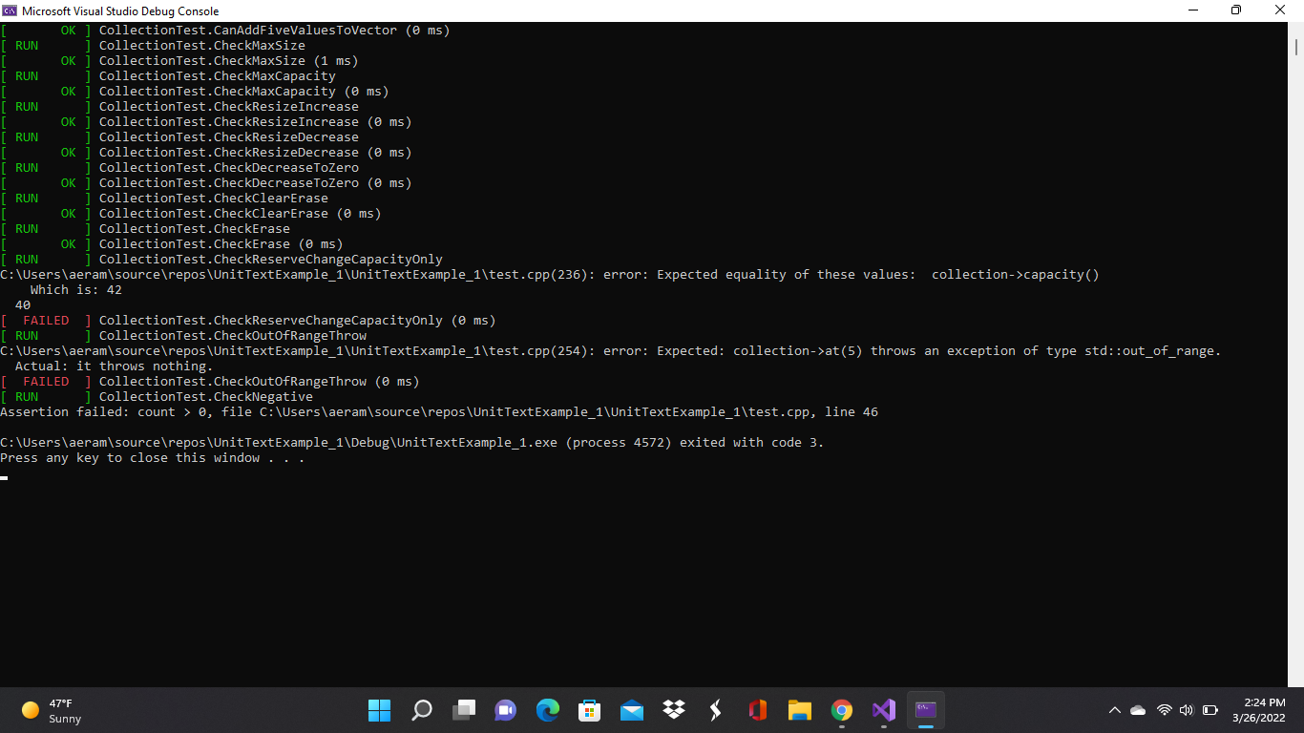
Unit Testing
Unit testing will be performed to ensure that each area of the code is secure and functions as it is intended. Unit testing can be used to check that all functions work as intended and throw exceptions as required.
Notes:
Unit testing will be performed to ensure that each area of the code is secure and functions as it is intended. Unit testing can be used to check that all functions work as intended and throw exceptions as required.

Slide 10

AUTOMATION SUMMARY
Notes:
This image depicts the DevSecOps pipeline and summarizes the automation process.

Slide 11
TOOLS
The DevSecOps pipeline is a secure coding technique that integrates security throughout the entire lifecycle of the program.
DevSecOps stands for development, security, and operations.
There should be a predetermined security framework established that will be followed throughout all aspects of program pre-production and production.
The diagram (on the previous slide) displays techniques that should be followed to implement security into each step of the development lifecycle.
The benefits of adopting DevSecOps include:
Increased deployment of production with frequent working programs being deployed
Increased speed
Increased security
Notes:
The DevSecOps pipeline is a secure coding technique that integrates security throughout the entire lifecycle of the program. DevSecOps stands for development, security, and operations. There should be a predetermined security framework established that will be followed throughout all aspects of program pre-production and production. The diagram on the previous slide displays techniques that should be followed to implement security into each step of the development lifecycle. The benefits of adopting DevSecOps include increased deployment of production with frequent working programs being deployed, increased speed, and increased security.

Slide 12
RISKS AND BENEFITS
All forms and aspects of coding have security risks.
Techniques to reduce those risks should be pursued as much as possible.
Unsecure code can lead to loss of revenue, time, reputation, and personal information.
It is best to treat every program while always assuming that there are security threats.
Continued education on potential threats and updating this security policy as appropriate should be implemented to keep up with current threats.
Notes:
All forms and aspects of coding have security risks. Techniques to reduce those risks should be pursued as much as possible. Unsecure code can lead to loss of revenue, time, reputation, and personal information. If is best to treat every program while always assuming that there are security threats. Continued education on potential threats and updating this security policy as appropriate should be implemented to keep up with current threats.

Slide 13
RECOMMENDATIONS
New and potential threats will continuously affect the security of the system.
Regular maintenance of this security policy with updates made as appropriate is crucial to maintain the level of security that Green Pace requires and should be accountable for
Notes:
New and potential threats will continuously affect the security of the system. Regular maintenance of this security policy with updates made as appropriate is crucial to maintain the level of security that Green Pace requires and should be accountable for

Slide 14
CONCLUSIONS
Adopting the described policies will continue to keep the program secure. The following will help protect from future threats that may occur:
Default Deny
By default, access is denied unless certain conditions are met (Seacord, 2018).
Practice Defense in Depth
Utilize multiple layers of defense to prevent security breaches (Seacord, 2018).
Follow the Policy of Least Privilege
Every process should execute with the least privileges necessary to carry out the desired function (Seacord, 2018).
Notes:
Adopting all of the described policies will continue to keep the program secure. The following security principles have been highlighted due to their role in protecting from future threats that may occur: Default deny: by default, access is denied unless certain conditions are met. Practice defense in depth: utilize multiple layers of defense to prevent security breaches. Follow the policy of least privilege: Every process should execute with the least privileges necessary to carry out the desired function.

Slide 15
References
Ballman, A. & Britton, J. (2021, April 26). OOP58-CPP. https://wiki.sei.cmu.edu/confluence/display/cplusplus/OOP58-CPP.+Copy+operations+must+not+mutate+the+source+object
Ballman, A. & Britton, J. (2021, April 26). STR51-CPP. https://wiki.sei.cmu.edu/confluence/display/cplusplus/STR51-CPP.+Do+not+attempt+to+create+a+std%3A%3Astring+from+a+null+pointer
Ballman, A. & Britton, J. (2021, December 09). MEM51-CPP. https://wiki.sei.cmu.edu/confluence/display/cplusplus/MEM51-CPP.+Properly+deallocate+dynamically+allocated+resources

Slide 16
REFERENCES
Long, F. & O’Donnell, J. (2021, December 29). CTR51-CPP. https://wiki.sei.cmu.edu/confluence/display/cplusplus/CTR51-CPP.+Use+valid+references%2C+pointers%2C+and+iterators+to+reference+elements+of+a+container
Long, F. & O’Donnell, J. (2021, December 29). CTR53-CPP. https://wiki.sei.cmu.edu/confluence/display/cplusplus/CTR53-CPP.+Use+valid+iterator+ranges
Seacord, R. (2018, May 02). Top 10 Secure Coding Practices. https://wiki.sei.cmu.edu/confluence/display/seccode/Top+10+Secure+Coding+Practices
Seacord, R. & Britton, J. (2018, December 11). DCL03-C. https://wiki.sei.cmu.edu/confluence/display/c/DCL03-C.+Use+a+static+assertion+to+test+the+value+of+a+constant+expression

Slide 17
References
Seacord, R. & Britton, J. (2021, November 30). CON36-C. https://wiki.sei.cmu.edu/confluence/display/c/CON36-C.+Wrap+functions+that+can+spuriously+wake+up+in+a+loop
Seacord, R. & Gangopadhyay, A. (2021, July 19). ERR58-CPP. https://wiki.sei.cmu.edu/confluence/display/cplusplus/ERR58-CPP.+Handle+all+exceptions+thrown+before+main%28%29+begins+executing
Seacord, R. & Herter, J. (2020, August 13). STR02-C. https://wiki.sei.cmu.edu/confluence/display/c/STR02-C.+Sanitize+data+passed+to+complex+subsystems
Seacord, R. & Razmyslov, S. (2021, June 25). INT00-C. https://wiki.sei.cmu.edu/confluence/pages/viewpage.action?pageId=87152417

